Slide 1
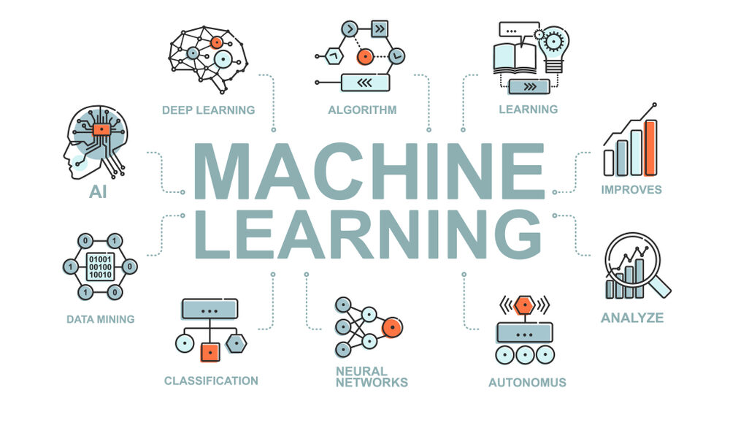
DEEP FAKE CLASSIFICATION USING MACHINE LEARNING

Slide 2
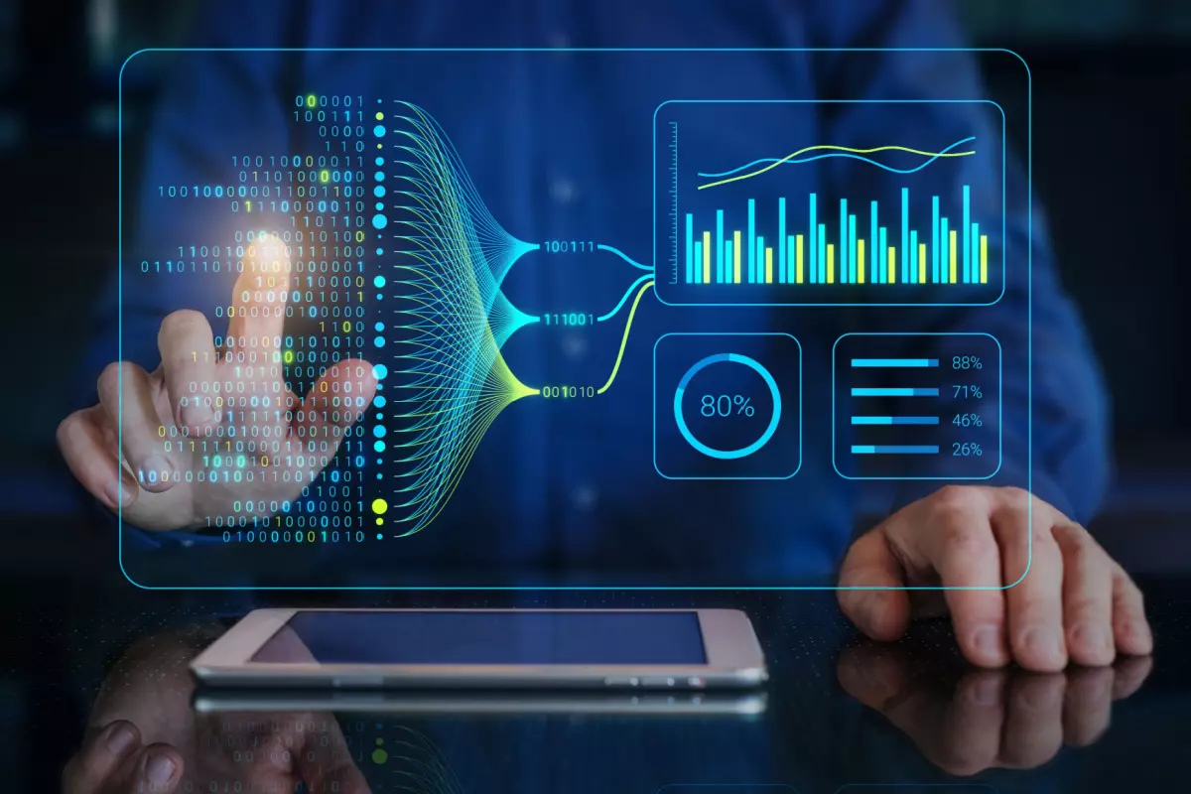
Guide:- Mr. Sourav Mondal Sir
Presented By:-
221FA04260 - MADHAV
221FA04342 - KARTHIKEYA
221FA04594 - DEEPIKA
221FA04678 – ABHINAYA
BATCH NUMBER:09

Slide 3
INDEX
Abstract
Introduction
Problem Statement
Dataset
Workflow
Requirements
Objective
Dataset selection and preprocessing
Model overview and Design
Work Timeline

Slide 4

ABSTRACT
Deepfake images in social media have been posing an enormous threat because they are disseminating false information, influencing public opinions, and further eroding people's trust in digital media. To counter this challenge, the proposed system here is based on ML techniques for proper classification and deepfake images detection. The advanced methods of image analysis in the system ensure the proper identification of manipulated content. ML models assess contextual metadata to improve classification accuracy, ensuring a robust and reliable solution to protect social media integrity.

Slide 5
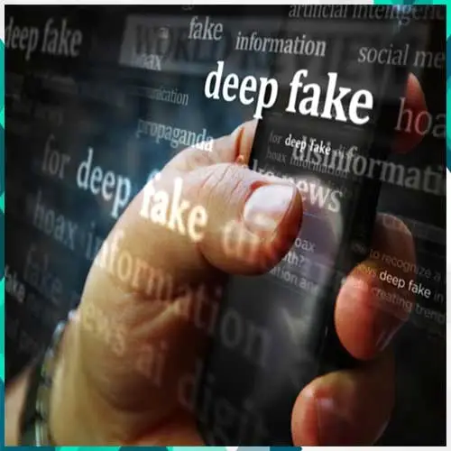
INTRODUCTION
Deepfake images have spread rapidly through the growing online presence of social media platforms, with threats including misinformation, manipulation of public perception, and erosion of trust in digital content. Detection and classification of deepfake images are critical to maintaining the integrity of such platforms. The main objective of this project is to create an intelligent system that uses techniques of Machine Learning to accurately detect and classify deepfake images. The system overcomes the problem of real-time detection, providing timely intervention in the process of protecting users from harmful and misleading content.

Slide 6
PROBLEM STATEMENT
Deepfake images spread on social media pose a severe threat by diffusing false information and eroding people's faith in online content. Their detection becomes problematic because the nature of manipulated images is complicated and the huge amount of online shared content overwhelms the search processes. Therefore, this project targets the creation of an accurate machine learning based system that can differentiate deepfake images to ensure authentic content and safety of users against fake information.

Slide 7

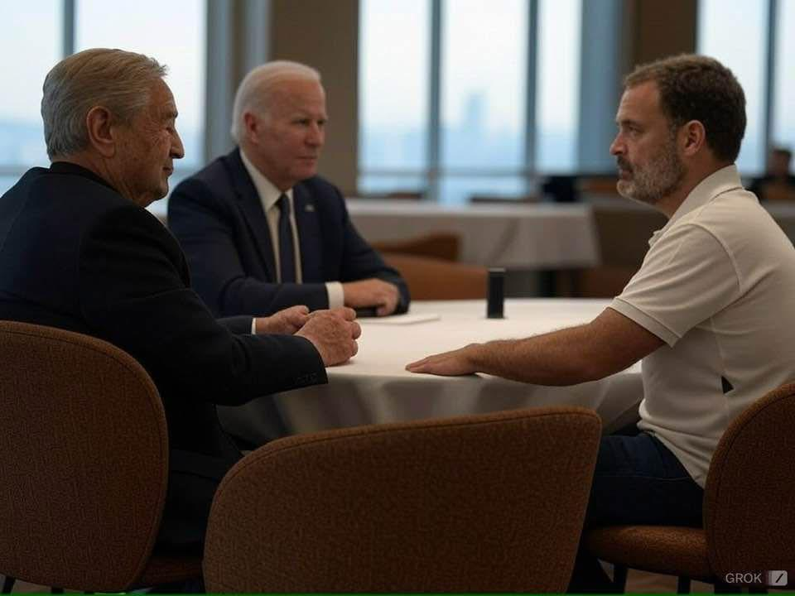

DATASET
SAMPLING DATA:-
Fig-a
Fig-b
Fig-c
Dataset Link: https:https://www.kaggle.com/datasets/dagnelies/deepfake-faces/data

Slide 8

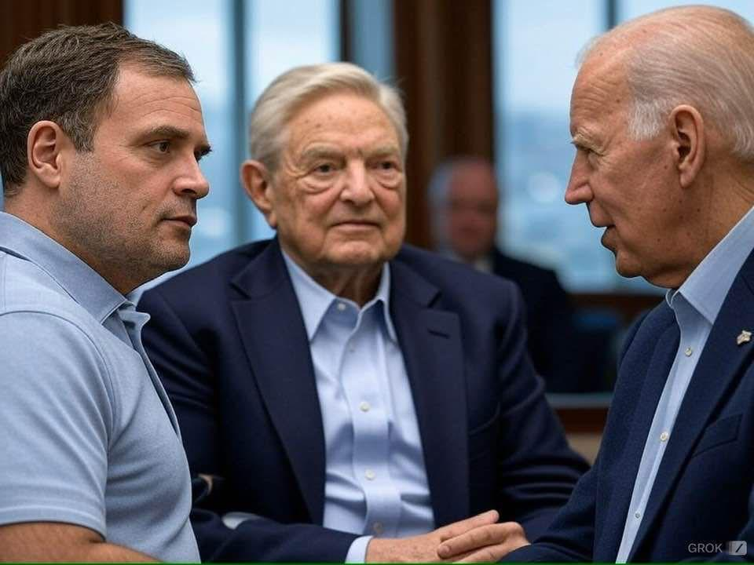
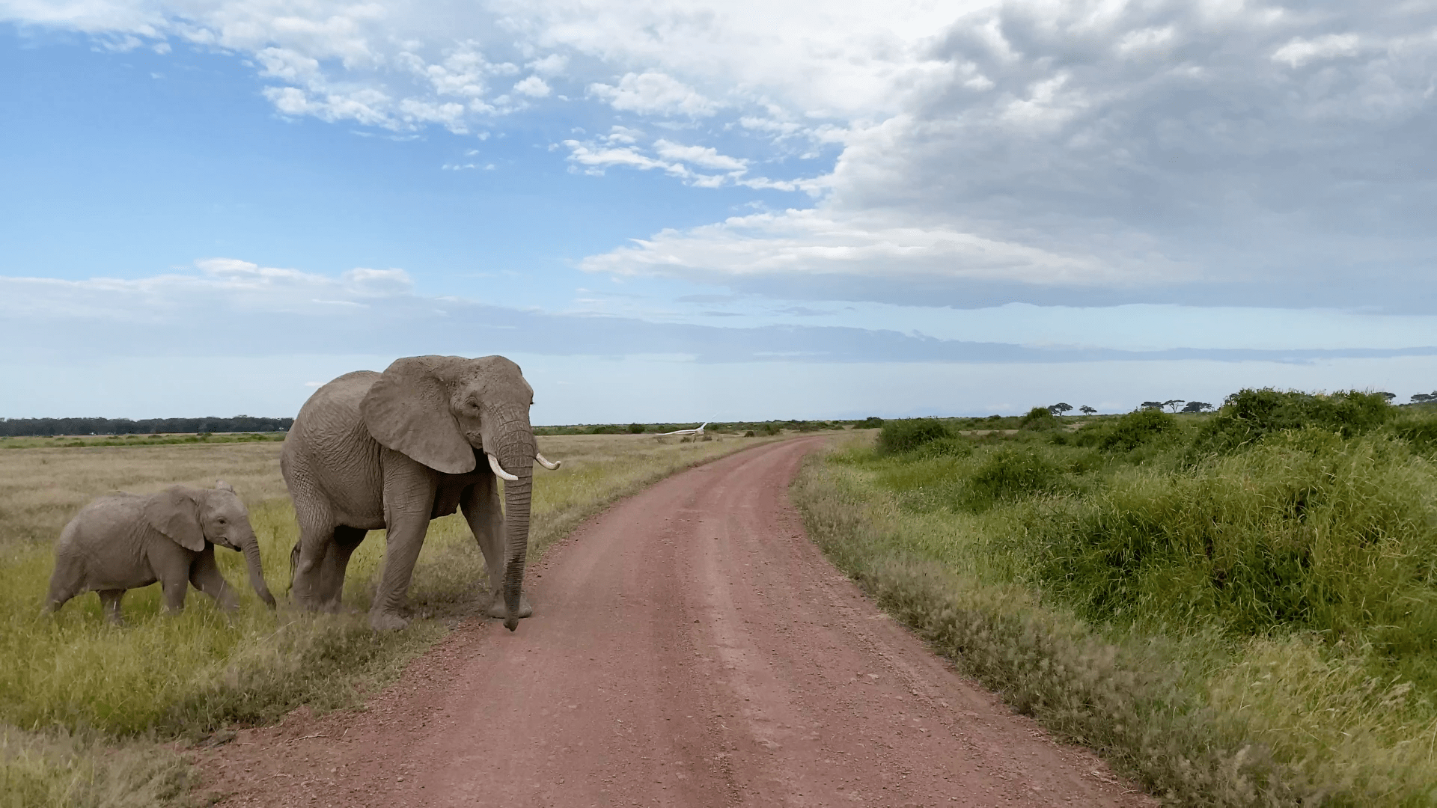
Fig-d
Fig-f
Fig-e

Slide 9
OBJECTIVE
The objective of deepfake image detection using machine learning is to develop accurate, efficient, and generalizable models capable of distinguishing real images from artificially generated ones. This involves enhancing detection accuracy while ensuring robustness against evolving deepfake generation techniques, including GANs and diffusion models. The goal is to create scalable solutions that can operate in real-time across various applications such as social media moderation, cybersecurity, digital forensics, and financial fraud prevention. Additionally, the detection models should be resilient to adversarial attacks and post-processing techniques like compression, cropping, and noise addition.
Another key objective is to improve interpretability, enabling forensic experts, journalists, and legal professionals to understand and trust detection results. Ethical considerations, including privacy protection and responsible AI deployment, are also central to ensuring that deepfake detection is used for security and misinformation prevention without infringing on user rights.

Slide 10
CHALLENGES
Detecting deepfake images using machine learning presents several challenges, including:
1. High-Quality Deepfakes
Modern generative models (e.g., StyleGAN, DALL·E, Stable Diffusion) produce hyper-realistic deepfakes, making detection harder.
Artifacts like unnatural textures or inconsistencies are becoming less prominent.
2. Generalization Issues
A model trained on one type of deepfake (e.g., GAN-based) may not detect another type (e.g., diffusion-based).
Distribution shifts (different lighting, poses, backgrounds) reduce accuracy.
3. Lack of Large and Diverse Datasets
Most datasets are limited in scope and may not cover all deepfake techniques.
Real-world deepfakes evolve quickly, making past datasets obsolete.

Slide 11
Contd….
4. Adversarial Attacks
Attackers can modify images to evade detection (e.g., adversarial noise).
Small perturbations can mislead classifiers.
5. Computational Cost
Training and running deepfake detection models require high computational resources.
6. Limited Labeled Datasets
Deep learning models require large volumes of high-quality, labeled data. However, gathering diverse and well-annotated datasets that cover a wide range of deepfake techniques remains a significant challenge.
7.Blending of Real and Fake Content
Some deepfakes only partially modify an image (e.g., just the mouth region), making detection harder since the manipulation may be subtle and localized.

Slide 12
REQUIREMENTS
Hardware Requirements:-
GPU: NVIDIA RTX 3060 or better.
RAM: 16 GB or more.
Storage: 1 TB SSD.
Processor: Intel Core i7 or equivalent.
Software Requirements:-
OS: Windows 10/11 or Ubuntu 20.04+.
Language: Python 3.8+.
Frameworks: TensorFlow, PyTorch, OpenCV.
Tools: Jupyter Notebook, Flask / FastAPI, Git.

Slide 13
APPLICATIONS
Deepfake image detection using machine learning has several critical applications across different domains:
1. Digital Forensics & Cybersecurity
Fake Image Verification: Identifying altered or fake images used in cybercrimes.
Preventing Identity Theft: Detecting deepfake-generated images in phishing or fraud attempts.
2. Social Media & Content Moderation
Fake News Prevention: Detecting manipulated images used in misinformation campaigns.
Platform Integrity: Ensuring platforms (Facebook, Twitter, Instagram) remove harmful deepfake content.
3. Law Enforcement & National Security
Criminal Investigation: Identifying tampered images in evidence.
Countering Disinformation: Detecting deepfake images used for propaganda or fake identities.
4. Financial Sector & Authentication
KYC (Know Your Customer) Verification: Ensuring uploaded identity documents are not deepfakes.
Fraud Detection: Preventing deepfake-based impersonation in banking and insurance.

Slide 14
5. Medical Imaging & Healthcare
Fake Medical Reports: Detecting altered scans or reports used for fraud.
6.E-commerce & Online Marketplaces
Product authenticity: Spotting fake product photos in online listings.
Customer review validation: Detecting AI-generated user photos in fake reviews.
5. Government & Border Security
Passport & visa authentication: Detecting image tampering in official travel documents.
Surveillance validation: Ensuring images from CCTV or border control are authentic and not AI-generated.
4. Finance & Banking
KYC (Know Your Customer): Identifying deep fake images used in identity theft during account creation.
Insurance fraud detection: Spotting doctored evidence in image-based insurance claims.

Slide 15
LITERATURE SURVEY
[1] Li et al. (2020) developed Celeb-DF and used temporal convolution networks (TCNs) to improve robustness against manipulations, though it was primarily focused on celebrity videos. Sabir et al. (2019) proposed a CNN-RNN hybrid model for sequential frame analysis, improving temporal detection but struggling with isolated frames.
[2] Korshunov et al. (2019) focused on audio-visual inconsistency detection, successfully identifying lip-sync mismatches but struggling with high-quality deepfakes. Chollet (2017) presented the Xception model, a CNN-based deepfake detector with high accuracy but high computational demands. Nguyen et al. (2020) introduced FakeFinder, a multimodal detection approach that improved accuracy but was complex to implement.
[3]Rössler et al. (2019) proposed FaceForensics++, using CNNs for facial deepfake detection with high accuracy but limited effectiveness on advertisements. Dolhansky et al. (2020) introduced an ensemble learning approach for the DFDC, achieving good performance across diverse deepfakes but lacking specialization in ads. Afchar et al. (2018) developed MesoNet, a lightweight CNN effective for low-resolution deepfakes but struggled with high-resolution videos.

Slide 16
Contd….
[4] Nguyen et al. (2019, 2020) explored capsule networks and multitask CNNs to improve deepfake detection by enhancing robustness to spatial transformations. Their models showed strong generalization capabilities across various manipulation types but required complex tuning and longer training times.
[5] Li et al. (2020) released the Celeb-DF dataset, which focuses on more realistic celebrity deepfakes, and introduced temporal convolution networks (TCNs) for robust manipulation detection. However, their work primarily targeted celebrity images and did not generalize well to broader datasets.
[6] Dang et al. (2020) leveraged self-attention mechanisms with CNNs to capture subtle manipulation cues within facial regions. Although effective, the model demands significant computational resources and large-scale training data. Masi et al. (2020) suggested a patch-based CNN approach, emphasizing localized manipulation detection, which improved precision but lacked robustness for global image tampering.

Slide 17
MOTIVATION
The rapid advancements in artificial intelligence have led to the creation of highly realistic deepfake images, posing significant threats to digital media integrity. Deepfakes are increasingly being used for misinformation, identity fraud, and malicious activities such as political manipulation and financial scams. Traditional detection techniques struggle to keep up with evolving deepfake generation models, making it essential to develop robust machine learning-based solutions. This project aims to enhance deepfake detection by leveraging deep learning models to improve accuracy, generalization, and real-time performance. By addressing the challenges posed by high-resolution deepfakes, adversarial attacks, and multimodal manipulations, the project seeks to contribute to the development of secure and trustworthy digital environments.

Slide 18
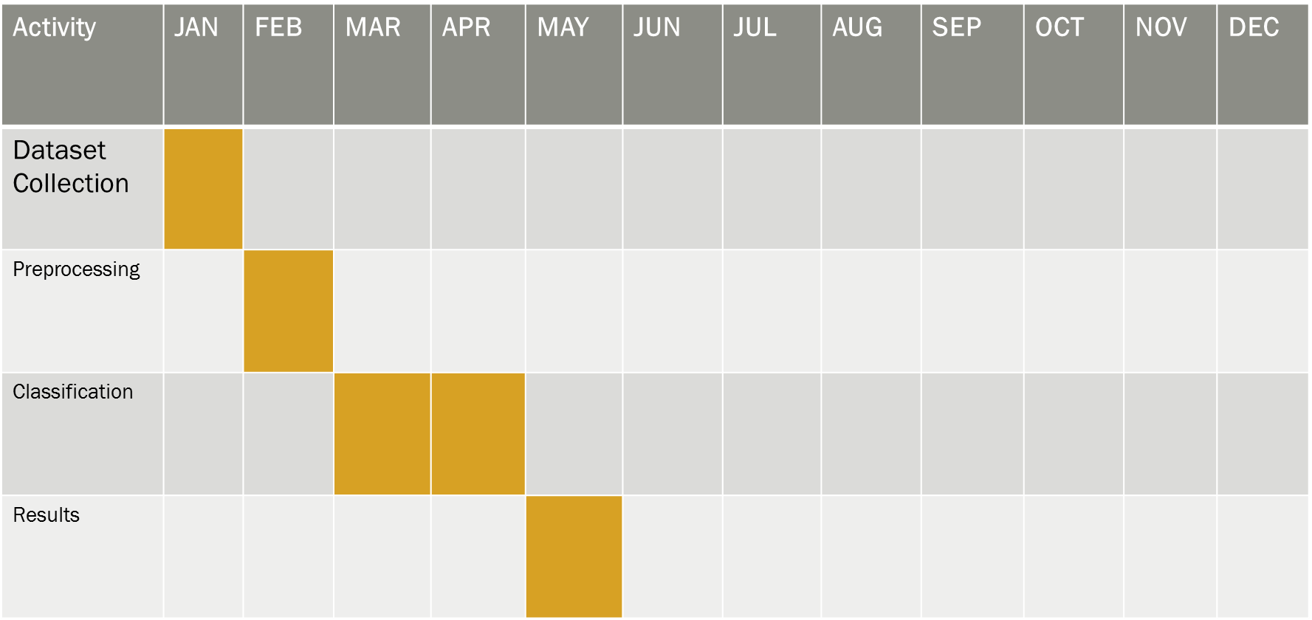
WORK TIMELINE

Slide 19
WORKFLOW

Slide 20
RESULTS
Fig-b Performance Outcomes
Fig-c Dialogical comparision of Training Vs Testing
Fig-a Confusion Matrix

Slide 21
CONCLUSION
In conclusion, the increasing prevalence of deepfake content presents significant challenges to digital media integrity, necessitating robust detection mechanisms. Through the comprehensive dataset preparation and preprocessing pipeline outlined in this project, we have established a strong foundation for developing effective machine learning models capable of accurately distinguishing between real and manipulated advertisements.
Leveraging techniques such as frame extraction, face detection, normalization, and data augmentation ensures the dataset's quality and enhances model performance. Future work will focus on improving model generalization, adapting to emerging deepfake generation techniques, and integrating real-time detection capabilities to combat the evolving threats posed by deepfake media.

Slide 22
REFERENCES
Adadi A (2021) A survey on data-efficient algorithms in big data era. J Big Data 8(1):1–54
Afchar D, Nozick V, Yamagishi J et al (2018) MesoNet: a compact facial video forgery detection network. In: 2018 IEEE international workshop on information forensics and security (WIFS). IEEE, pp 1–7
Agarwal S, Farid H, Gu Y et al (2019) Protecting world leaders against deep fakes. In: CVPR workshops. pp 38–45
Agarwal S, Farid H, Fried O et al (2020) Detecting deep-fake videos from phoneme-viseme mismatches. In: Proceedings of the IEEE/CVF conference on computer vision and pattern recognition workshops. pp 660–661
Aghasanli A, Kangin D, Angelov P (2023) Interpretable-through-prototypes deepfake detection for diffusion models. In: Proceedings of the IEEE/CVF international conference on computer vision. pp 467–474
Akhtar Z (2023) Deepfakes generation and detection: a short survey. J Imaging 9(1):18

Slide 23
Contd….
Dang, H., Liu, F., Stehouwer, J., Liu, X., & Jain, A. K. (2020). On the Detection of Digital Face Manipulation. In Proceedings of the IEEE/CVF Conference on Computer Vision and Pattern Recognition (CVPR) (pp. 5781–5790).
Korshunov, P., & Marcel, S. (2019). DeepFakes: a New Threat to Face Recognition? Assessment and Detection. arXiv preprint arXiv:1812.08685.
Li, Y., Chang, M. C., & Lyu, S. (2020). Celeb-DF: A Large-Scale Challenging Dataset for DeepFake Forensics. In Proceedings of the IEEE/CVF Conference on Computer Vision and Pattern Recognition (CVPR) (pp. 3207–3216).
Masi, I., Killekar, A., Tarsitano, A., Mascetti, S., & Natarajan, P. (2020). Two-Branch Recurrent Network for Isolating Deepfakes in Videos. In European Conference on Computer Vision (ECCV) (pp. 667–684). Springer.
Dolhansky, B., Bitton, J., Pflaum, B., Lu, J., Howes, R., Wang, M., & Ferrer, C. C. (2020). The Deepfake Detection Challenge Dataset. arXiv preprint arXiv:2006.07397.

Slide 24
THANK YOU

